Slide 2
The Direction of Intention
My God, give me the grace to perform this action with you and through love for you. In advance, I offer to you all the good that I will do and accept all the difficulty I may meet therein. St. Ann, Pray for us.
St. Francis de Sales, Pray for us.

Slide 3
Overview
June 5: Introduction to the Book of Psalms
June 12: Psalms of Praise
June 19: Psalms of Lamentation
June 26: No Session
July 3: No Session
July 10: Psalms of Thanksgiving Royal Psalms and
Psalms of Wisdom
July 17: The Theology of the Psalms
July 24: Learning to Pray the Psalms –
Liturgy of the Hours

Slide 4
Theology of the Psalms
What do we discover about God in the Psalms?
Anthropomorphic Language
Anthropomorphism, refers to the representation of God with the forms of humanity (such as an arm or hand).
Example: Psalm 34
¹⁵ The eyes of the Lord are on the righteous, and his ears are attentive to their cry; ¹⁶ but the face of the Lord is against those who do evil, to blot out their name from the earth.

Slide 5
Theology of the Psalms
Anthropopathism refers to the representation of God with the feelings of humanity.
Example: Psalm 5
For you are not a God who is pleased with wickedness; with you, evil people are not welcome. ⁵ The arrogant cannot stand in your presence. You hate all who do wrong; ⁶ you destroy those who tell lies. The bloodthirsty and
deceitful you, Lord, detest.
Anthropopraxism refers to the representation of God with the activities of humanity.
Example: Psalm 37
¹³ but the Lord laughs at the wicked, for he knows their day is coming.

Slide 6
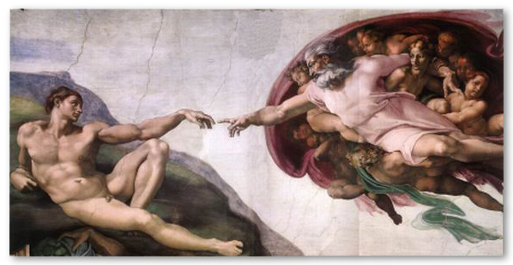
Warning against being too Literal
A number of strange-sometimes heretical-doctrines have emerged among some religious groups as a result of misunderstanding anthropomorphic language.
For example, Mormons conclude that God is a physical being because, among other reasons, Moses spoke with God “face to face”
Misinterpreting anthropomorphic language can lead one far astray doctrinally.

Slide 7
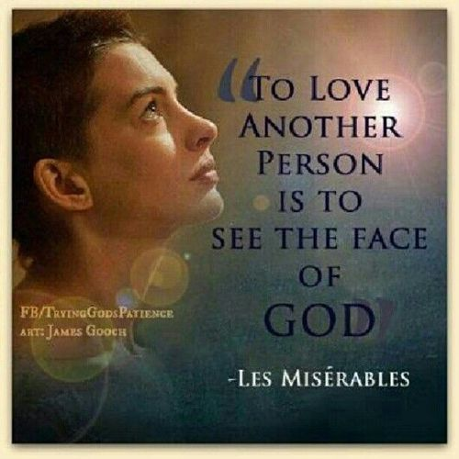
Theology of the Psalms
The Theology of the Psalms:
IS NOT abstract or systematic
Reveals the TRUE nature of God
IS doxological, an expression of Praise
IS confessional, an expression of belief
IS practical, how we come to know God more fully

Slide 8
Major Theological Themes
God is the Center of all Life
The conviction that the center of life (of right human understanding, trust, hope, service, morality, adoration), but also of history and of the whole creation (heaven and earth), is God.
Things visible and invisible
Creates, preserves and robes all things in his Glory
“true” identity (no chaos there).
Psalm 146
God is a great, benevolent and Fatherly King

Slide 9
Major Theological Themes
God holds absolute sovereignty
God ultimately will not tolerate any worldly power that opposes or denies or ignores him.
He will come to rule the nations so that all will be compelled to acknowledge him.
The Psalmists was not only writing for a particular period of time
The psalmists presents a long view of the future.
Because the Lord is the Great King beyond all challenge, his righteous and peaceable kingdom will come, overwhelming all opposition and purging the creation of all rebellion against his rule—such will be the ultimate outcome of history.

Slide 10
Major Theological Themes
All Creation depends on God
God opposes the “proud,” those who rely on their own resources (and/or the gods they have contrived) to work out their own destiny.
These are the ones who ruthlessly wield whatever power they possess to attain worldly wealth, status and security; who are a law to themselves and exploit others as they will.
In the Psalter, this kind of “pride” is the root of all evil.
Those who embrace it, though they may seem to prosper, will be brought down to death, their final end.
The “humble,” the “poor and needy,” those who acknowledge their dependence on the Lord in all things—these are the ones in whom God delights.
Thus the “fear of the Lord”—i.e., humble trust in and obedience to the Lord—is the “beginning” of all wisdom (111:10).
Ultimately, those who embrace it will inherit the earth. Not even death can hinder their seeing the face of God.

Slide 11
Major Theological Themes
God is the ultimate Executor of justice among humans
(to avenge oneself is an act of the “proud”).
God is the court of appeal when persons are threatened or wronged—especially when no earthly court that he has established has jurisdiction (as in the case of international conflicts) or is able to judge (as when one is wronged by public slander) or is willing to act (out of fear or corruption).
He is the mighty and faithful Defender of the defenseless and the wronged.
He knows every deed and the secrets of every heart. There is no escaping his scrutiny.
No false testimony will mislead him in judgment. And he hears the pleas brought to him.
As the good and faithful Judge, he delivers those who are oppressed or wrongfully attacked and redresses the wrongs committed against them

Slide 12
Major Theological Themes
God has chosen Israel to be his servant people, his “inheritance” among the nations.
He has delivered them by mighty acts out of the hands of the world powers, he has given them a land of their own (territory that he took from other nations to be his own “inheritance” in the earth), and he has united them with himself in covenant as the initial embodiment of his redeemed kingdom.
To Israel he gives his word of revelation, which testified of him, made specific his promises and proclaimed his will.
She was to trust solely in his protection, hope in his promises, live in accordance with his will and worship him exclusively.
She was to sing his praises to the whole world—which in a special sense revealed Israel’s anticipatory role in the evangelization of the nations.

Slide 13
Major Theological Themes
God chose David to be his royal representative on earth.
David was the Lord’s “servant”
The Lord himself anointed him and adopted him as his royal “son” to rule in his name.
God promised to preserve the Davidic dynasty.
David was to be more than a warrior king.
Endowed by God to govern his people with godlike righteousness: to deliver the oppressed, defend the defenseless, suppress the wicked, and thus bless the nation with internal peace and prosperity.
He was also an intercessor with God in behalf of the nation, the builder and maintainer of the temple (as God’s earthly palace and the nation’s house of prayer) and the foremost voice calling the nation to worship the Lord.

Slide 14
Do the Psalms speak of the Christ?
Yes, in a variety of ways—but not as the prophets do.
The Psalter was never numbered among the “prophetic” books.
The Psalms written much earlier than the Prophets would be seen to reinforce from the past what was hoped for in the future.
When the Psalms speak of the king on David’s throne, they speak of the king who is being crowned (as in Ps 2; 72; 110)
David is the Lord’s anointed and God will accomplish all through his dynasty.
So the NT quotes these psalms as testimonies to Christ, which in their unique way they are. In him they are truly fulfilled.

Slide 15
Do the Psalms Speak of Christ?
The Suffering Servant (s)
That suffering reaches into the future…even until the end of time to embrace all who are innocent, not having provoked or wronged their adversaries, and because they are among the “humble” who trust in the Lord—cry out to God in their distress (as in Ps 22; 69)
The Psalms give voice to the sufferings of God’s servants in a hostile and evil world.
When Christ came in the flesh, he identified himself with God’s “humble” people in the world.
He became for them God’s righteous servant par excellence, and he shared their sufferings at the hands of the wicked.
Thus these prayers became his prayers also—uniquely his prayers. In him the suffering and deliverance of which these prayers speak are fulfilled (though they continue to be the prayers also of those who take up their cross and follow him).

Slide 16
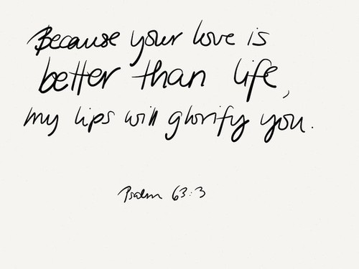
Summary
The Psalms give voice to Israel's the past
But speak in a present voice
Thus they become the words of Jesus and of his Church

